Slide 1
Genetic Algorithms
Varun Deshmukh
Assistant Professor
Department of Computer Engineering
MPSTME, Shirpur Campus

Slide 2
Introduction
Solving problem means looking for solutions, which is best among others.
Finding solution to a problem is often thought:
In computer science and AI, as a process of search through the space of possible solutions. The set of possible solutions define the search space for a given problem. Solutions or partial solutions are viewed as points in search space.
In engineering and mathematics, as a process of optimization. The problems are first formulated as mathematical model expressed in terms of functions and then to find a solution, discover the parameters that optimize the model or the function components that provide optimal system performance.

Slide 3
Why Genetic Algorithms?
It is better than conventional AI; it is more robust.
Unlike older AI systems, the GA’s do not break easily even if the input changed slightly, or in the presence of reasonable noise.
While performing search in large state-space, multi model state-space, or n- dimensional surface, genetic algorithms offer significant benefits over many other typical search optimization techniques like – linear programming, heuristic, depth-first, breath-first.
“Genetic algorithm are good at taking large, potentially huge search spaces and navigating them, looking for optimal combinations of things, the solution one might not otherwise find in lifetime.” Salvatore Mangano Computer design, may 1995.

Slide 4
Optimization
Optimization is process that finds a best, or optimal, solution for problem. The optimization problem are centered around three factors:
An objective function: which is to be minimized or maximized
Examples
In manufacturing, we want to maximize the profit or minimize the cost.
In designing an automobile panel, we want to maximize the strength.
A set of unknowns or variables: that affects the objective function,
Examples
In manufacturing, the variables are amount of resources used or the time spent.
In panel design problem, the variables are shape and dimensions of the panel.
A set of constraints: that allow the unknowns to take on certain values but exclude others;
Examples
In manufacturing, one constrain is, that all “time” variables to be non-negative.
In the panel design, we want to limit the weight and put constrain on its shape.
An optimization problem is defined as: finding values of the variables that minimize or maximize the objective function while satisfying the constraints.

Slide 5
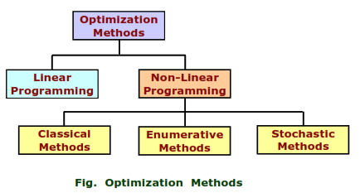
Optimization Methods
Many optimization methods exist and categorized as shown below;
The suitability of a method depends on one or more problem characteristics to be optimized to meet one or more objectives like:
Low cost
High performance
Low loss
These characteristics are not necessarily obtainable, and require knowledge about the problem.

Slide 6
Limitations of the traditional optimization approaches
Limitations:
Computationally expensive.
For a discontinuous objective function, methods may fail.
Method may not be suitable for parallel computing.
Discrete (integer) variables are difficult to handle.
Methods may not necessarily adaptive.
Evolutionary algorithms have been evolved to address the above mentioned limitations of solving optimization problems with traditional approaches.

Slide 7
Genetic Algorithms (GA’S) – Basic concept
Genetic algorithms (GA’S) are the main paradigm of evolutionary computing. GA’s are inspired by Darwin’s theory about evolution- “the survival of fittest”. In nature, competition among individuals dominating over the weaker ones.
GA’s are the ways of solving problems by mimicking processes nature uses; i.e. selection, crossover, mutation and accepting, to evolve a solution to problem.
GA’s are adaptive heuristic search based on the evolutionary ideas of natural selection and genetics.
GA’s are intelligent exploitation of random search used in optimization problems.
GA’s, although randomized, exploit historical information to direct the search into the region of better performance within the search space.
The biological background (basic genetics), the scheme of evolutionary processes.

Slide 8
Biological Background – Basic Genetics
Every organism has a set of rules, describing how that organism is built. All living organism consist of cells.
In each cell there is same set of chromosomes. Chromosomes are string of DNA and serve as a model for the whole organism.
A chromosomes consist of genes, Blocks of DNA.
Each gene encodes a particular protein that represents a trait (Features), e.g. color of eyes.
Possible setting of traits (e.g. blue, brown) are called alleles.
Each gene has its own position in chromosome called its locus.
Complete set of genetic material (All Chromosomes) is called genome.
Particular set of genes in genome is called genotype.
The physical expression of genotype (the organism itself after birth) is called phenotype, its physical and mental characteristics, such as color of eyes, intelligence etc.
When two organisms mate they share their genes; the resultant offspring may end up having half the genes from one parent and half from other. This process is called recombination (crossover).
The new created offspring can then be mutated. Mutation means, that the elements of DNA are bit changed. This changes are mainly caused by errors in copying genes from parents.
The fitness of an organism is measured by success of the organism in its life (Survival).

Slide 9
Working principle
Before getting into GA’s, it is necessary to explain few terms,
Chromosome: a set of genes; a chromosomes contains the solution in the form of genes.
Gene: a part of chromosome; a gene contains part of solution. It determines the solution. e.g. 16743 is chromosome and 1, 6, 7, 4 and 3 are its genes.
Individual: same as chromosome.
Population: number of individuals present with same length of chromosome.
Fitness: the value assigned to an individual based on how far or close a individual is from the solution, greater the fitness value better the solution it contains.
Fitness function: a function that assigns fitness value to the individual. It is problem specific.
Breeding: taking two fit individuals and then intermingling there chromosome to create two new individuals.
Mutation: changing random gene in an individual.
Selection: selecting individuals for creating next generation.

Slide 10
Working principle
Genetic algorithm begins with set of solutions called the population.
Solutions from one population are taken and used to form a new population. This is motivated by the possibility that the new population will be better the old one.
Solutions are selected according to their fitness to form new solutions (offspring); more suitable they are, more chances they have to reproduce.
This is repeated until some condition (e.g. number of populations or improvements of the best solution) is satisfied.

Slide 11
Outline of the basic Genetic algorithm
[Start] Generate random population of n chromosomes (i.e. suitable solutions for the problem).
[Fitness] Evaluate the fitness f(x) of each chromosome x in the population.
[New population] Create a new population by repeating following steps until the new population is complete.
[Selection] select two parent chromosome from a population according to their fitness (better the fitness, bigger the chance to be selected).
[Crossover] with a crossover probability, cross over the parents to form new offspring (children). If no crossover was performed, offspring is exact copy of parents.
[Mutation] with a mutation probability, mutate new offspring at each locus (position in chromosome).
[Accepting] place new offspring in the new population.
[Replace] use new generated population for a further run of the algorithm.
[Test] if the end condition is satisfied, stop, and return the best solution in current population.
[Loop] Go to step 2
Note: the genetic algorithms performance is largely influenced by two operators called crossover and mutation. These two operators are the most important parts of GA.

Slide 12
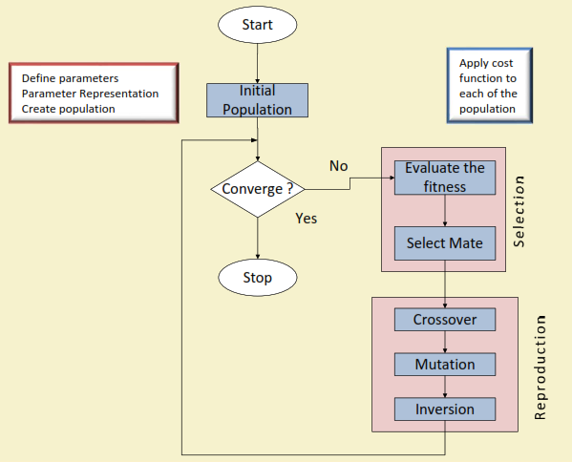
Framework of GA

Slide 13
GA operators
In fact, a GA implementation involved with the realization of the following operations.
1. Encoding: How to represent a solution to fit with GA framework.
2. Convergence: How to decide the termination criterion.
3. Mating pool: How to generate next solutions.
4. Fitness Evaluation: How to evaluate a solution.
5. Crossover: How to make the diverse set of next solutions.
6. Mutation: To explore other solution(s).
7. Inversion: To move from one optima to other.

Slide 14
Different GA Strategies
1. Simple Genetic Algorithm (SGA)
2. Steady State Genetic Algorithm (SSGA)

Slide 15
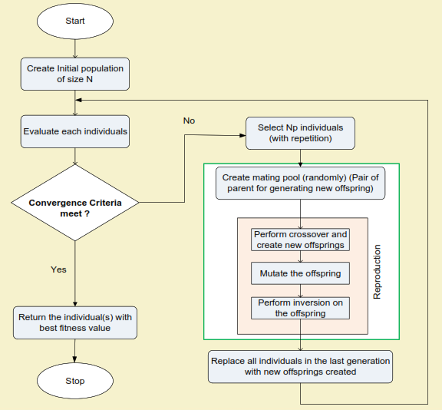
Simple Genetic Algorithm (SGA)

Slide 16
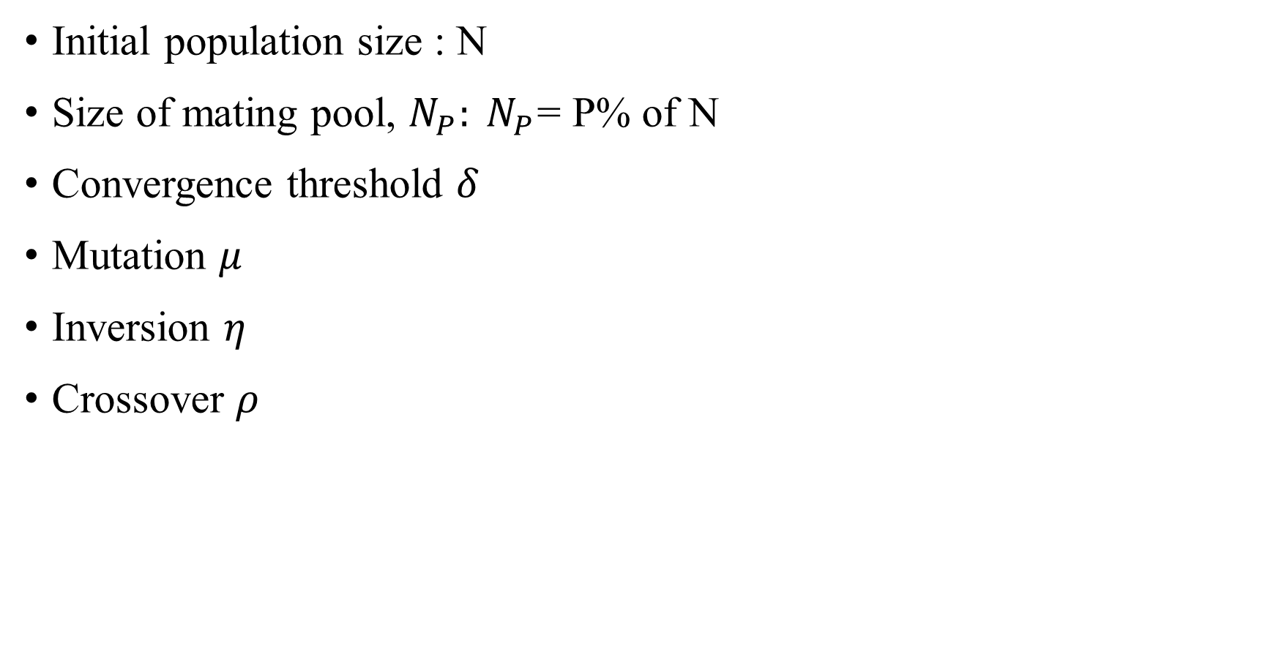
SGA Parameters
Initial population size : N
Size of mating pool, $N_{P}: N_{P}$= P% of N
Convergence threshold $δ$
Mutation $μ$
Inversion $η$
Crossover $ρ$

Slide 17
Salient features in SGA
Have overlapping generation (Only fraction of individuals are replaced).
Computationally expensive.
Good when initial population size is large.
In general, gives better results.
Selection is biased toward more highly fit individuals; Hence, the average fitness (of overall population) is expected to increase in succession.
The best individual may appear in any iteration.

Slide 18
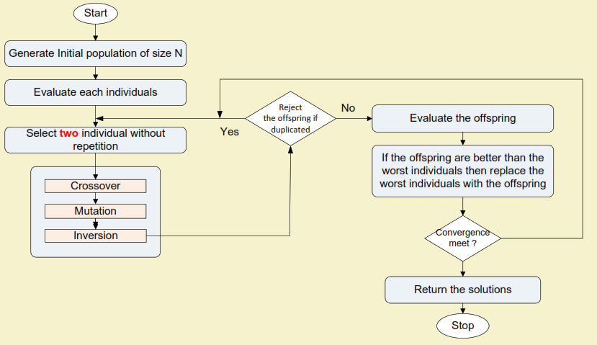
Steady State Genetic Algorithm (SSGA)

Slide 19
Salient features in Steady State GA
Generation gap is small.
Only two offspring are produced in one generation.
It is applicable when
Population size is small
Chromosomes are of longer length
Evaluation operation is less computationally expensive (compare toduplicate checking)

Slide 20
Limitations in SSGA:
There is a chance of stuck at local optima, if crossover/mutation/ inversion is not strong enough to diversify the population).
Premature convergence may result.
It is susceptible to stagnation. Inferiors are neglected or removed and keeps making more trials for very long period of time without any gain (i.e. long period of localized search).

Slide 21
Encoding Techniques:
There are many ways of encoding
Binary encoding: Representing a gene in terms of bits (0s and 1s).
Real value encoding: Representing a gene in terms of values or symbols or string.
Permutation (or Order) encoding: Representing a sequence of elements.
Tree encoding: Representing in the form of a tree of objects.

Slide 22
Binary Encoding:
Binary encoding is the most common to represent information contained.
In genetic algorithms, it was first used because of its relative simplicity.
In binary encoding, every chromosome is a string of bits: 0 or 1, like
chromosome 1: 1 0 1 1 0 0 1 0 1 1 0 0 1 0 1 0 1 1 1 0 0 1 0 1
chromosome 2: 1 1 1 1 1 1 1 0 0 0 0 0 1 1 0 0 0 0 0 1 1 1 1 1
Binary encoding gives many possible chromosomes even with a small number of alleles i.e. possible setting for a trait (features).
This encoding is often not natural for many problems and sometimes corrections must be made after crossover and/or mutation.

Slide 23
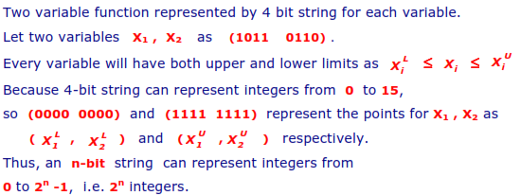
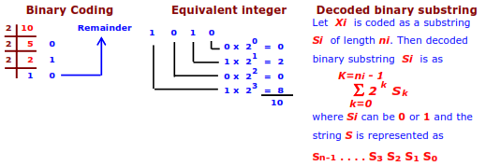
Binary Encoding:
Example 1: one variable function, say 0 to 15 numbers, numeric values, represented by 4 bit binary string.
Example 2:
Numeric Value | 4-bit string | Numeric Value | 4-bit string | Numeric Value | 4-bit string | Numeric Value | 4-bit string
0 | 0000 | 4 | 0100 | 8 | 1000 | 12 | 1100
1 | 0001 | 5 | 0101 | 9 | 1001 | 13 | 1101
2 | 0010 | 6 | 0110 | 10 | 1010 | 14 | 1110
3 | 0011 | 7 | 0111 | 11 | 1011 | 15 | 1111

Slide 24
Value Encoding: (Real Coded)
The value encoding can be used in problems where values such as real numbers are used. Use of binary encoding for this type of problems would be difficult.
In value encoding, every chromosome is a sequence of some values.
The values can be anything connected to problem, such as: real numbers, characters or objects.
Chromosome A 1.2324 5.3243 0.4556 2.3293 2.4545
Chromosome B ABDJEFJDHDIERJFDLDFLFEGT
Chromosome C (black), (black), (right), (forward), (left)
Value encoding is often necessary to develop some new types of crossovers and mutations specific for the problem.

Slide 25
Permutation (Order) Encoding:
Permutation encoding can be used in ordering problems, such as travelling salesman problem or task of ordering problem.
In permutation encoding, every chromosome is a string of numbers that represent a position in a sequence.
Chromosome A 1 5 3 2 6 4 7 9 8
Chromosome B 8 5 6 7 2 3 1 4 9
Permutation encoding is useful for ordering problems. For some problems, crossover and mutation corrections must be made to leave the chromosome consistent.
Examples:
The travelling salesman problem:
There are cities and given distances between them. Travelling salesman has to visit all of them, but he does not want to travel more than necessary. Find a sequence of cities with a minimal traveled distance. Here, encoded chromosomes describe the order of cities the salesman visits.
2. The Eight Queens problem:
There are eight queens. Find a way to place them on a chess board so that no two queens attack each other. Here, encoding describes the position of a queen on each row.

Slide 28
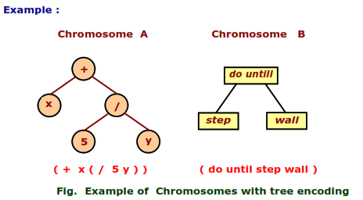
Tree Encoding:
Tree encoding is used mainly for evolving programs and expressions.
For genetic programming:
In tree encoding, every chromosome is a tree of some objects, such as functions or commands in programming language.
Tree encoding is useful for evolving programs or any other structures that can be encoded in trees.
The crossover and mutation can be done relatively easy way.
Note: Tree encoding is good for evolving programs. The programming language LISP is often used. Programs in LISP can be easily parsed as a tree, so the crossover and mutation is relatively easy.

Slide 29
Fitness Evaluation and Selection
GA Selection
After deciding an encoding scheme, the second important thing is how to perform selection from a set of population, that is, how to choose the individuals in the population that will create offspring for the next generation and how many offspring each will create.
The purpose of selection is, of course, to emphasize fittest individuals in the population in hopes that their offspring will in turn have even higher fitness.
Selection is the process of creating the population for next generation from the current generation.
To generate new population: Breeding in GA
Create a mating pool
Select a pair
Reproduce

Slide 30
Selection Schemes in GA’s
Different strategies are known for the selection:
Canonical selection (also called proportionate‐based selection)
Roulette Wheel selection (also called proportionate‐based selection)
Rank‐based selection (also called as ordinal‐based selection)
Tournament selection
Steady‐state selection

Slide 31
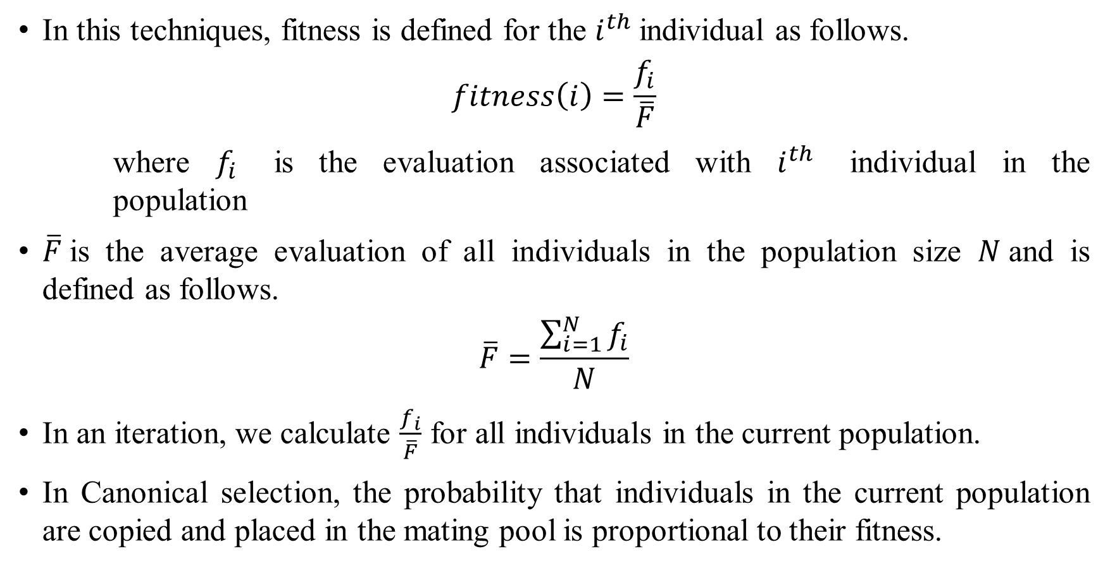
Canonical selection
In this techniques, fitness is defined for the $i^{th}$individual as follows.
$$fitness\left(i\right)=\frac{f_{i}}{\overline{F}}$$
where $f_{i}$ is the evaluation associated with $i^{th}$ individual in the population
$\overline{F}$is the average evaluation of all individuals in the population size $N$and is defined as follows.
$$\overline{F}=\frac{\sum_{i=1}^{N}{f_{i}}}{N}$$
In an iteration, we calculate $\frac{f_{i}}{\overline{F}}$ for all individuals in the current population.
In Canonical selection, the probability that individuals in the current population are copied and placed in the mating pool is proportional to their fitness.

Slide 32
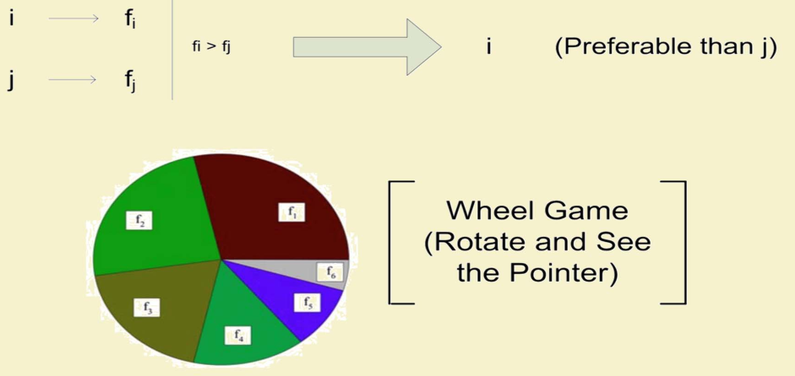
Roulette-Wheel selection:
In this scheme, the probability for an individual is being selected in the mating pool is considered to be proportional to its fitness.
It is implemented with the help of a wheel as shown in the next slide.

Slide 33
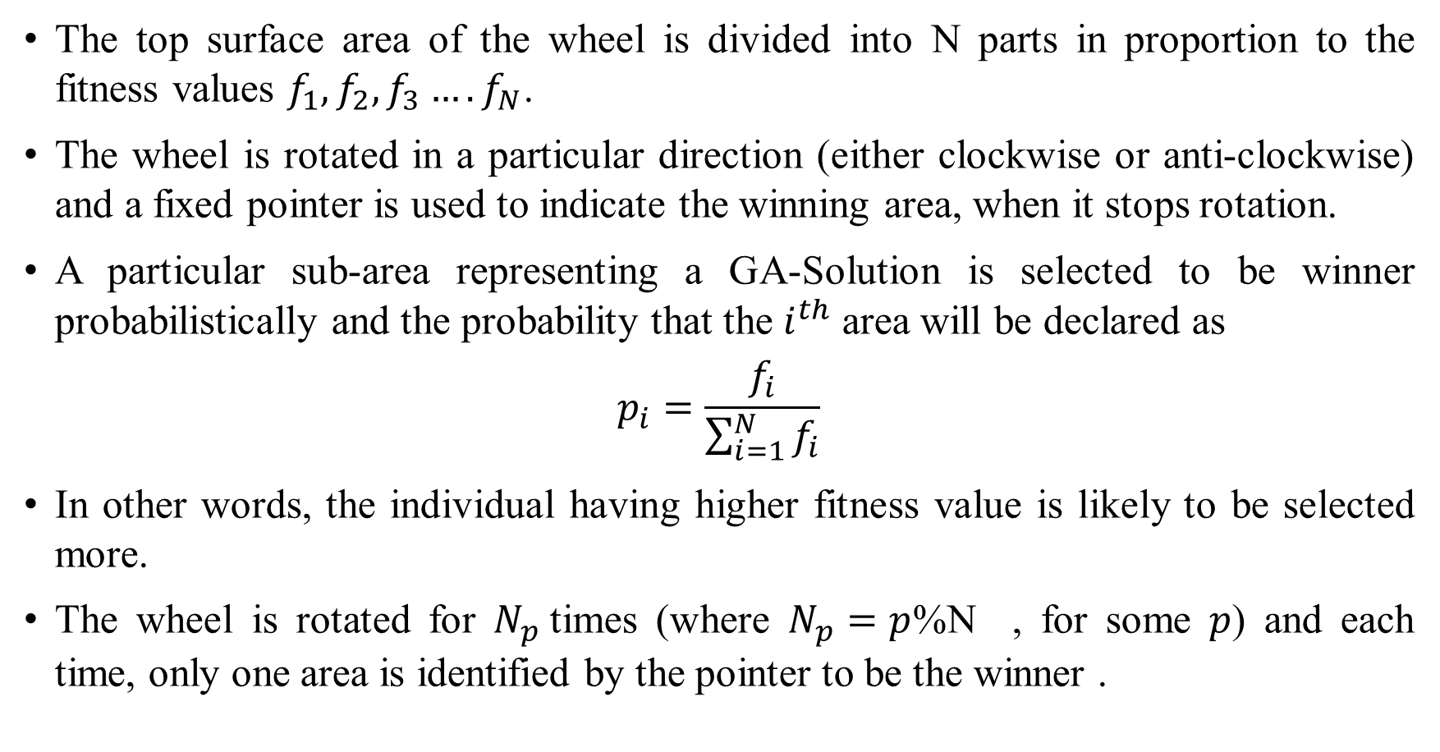
Roulette-Wheel selection:
The top surface area of the wheel is divided into N parts in proportion to the fitness values $f_{1},f_{2},f_{3}….f_{N}$.
The wheel is rotated in a particular direction (either clockwise or anti-clockwise) and a fixed pointer is used to indicate the winning area, when it stops rotation.
A particular sub‐area representing a GA‐Solution is selected to be winner probabilistically and the probability that the $i^{th}$ area will be declared as
$$p_{i}=\frac{f_{i}}{\sum_{i=1}^{N}{f_{i}}}$$
In other words, the individual having higher fitness value is likely to be selected more.
The wheel is rotated for $N_{p}$times (where $N_{p}=p$%N , for some $p$) and each time, only one area is identified by the pointer to be the winner .

Slide 34
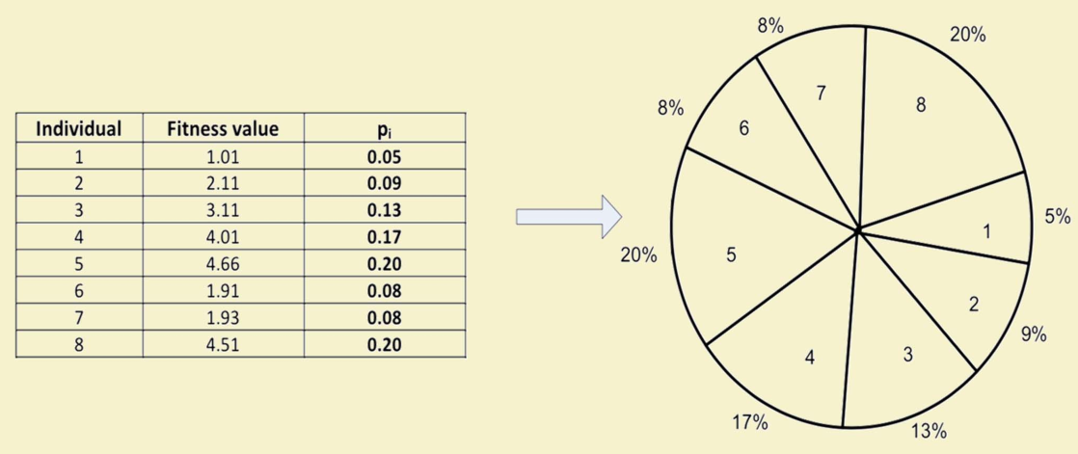
Roulette-Wheel selection: Example

Slide 35
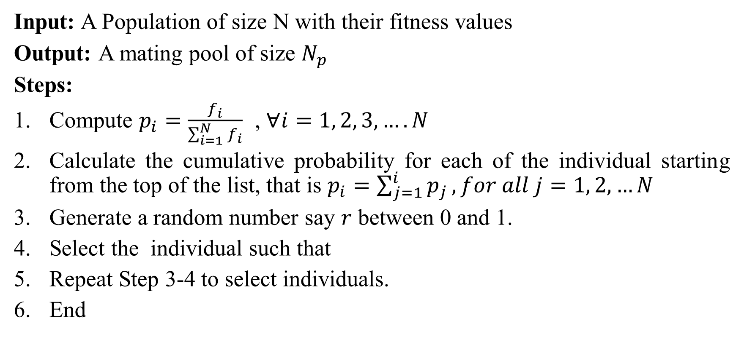
Roulette-Wheel selection: Implementation
Input: A Population of size N with their fitness values
Output: A mating pool of size $N_{p}$
Steps:
Compute $p_{i}=\frac{f_{i}}{\sum_{i=1}^{N}{f_{i}}}$ , $∀i=1, 2, 3, …. N$
Calculate the cumulative probability for each of the individual starting from the top of the list, that is $p_{i}=\sum_{j=1}^{i}{p_{j}}, for all j=1, 2, …N$
Generate a random number say $r$ between 0 and 1.
Select the individual such that
Repeat Step 3‐4 to select individuals.
End

Slide 36
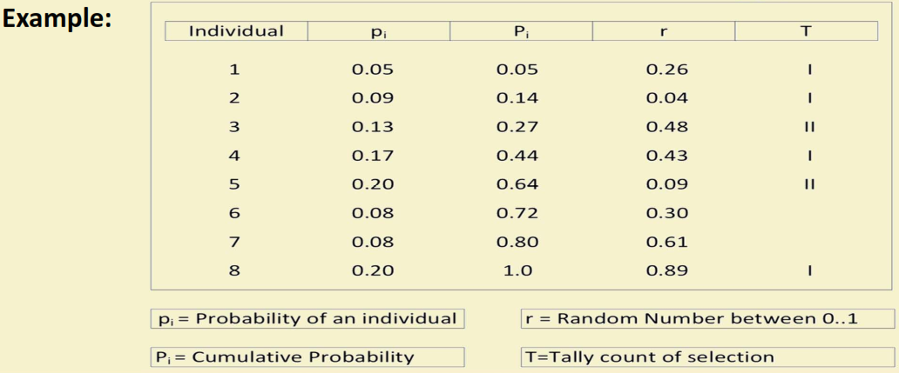
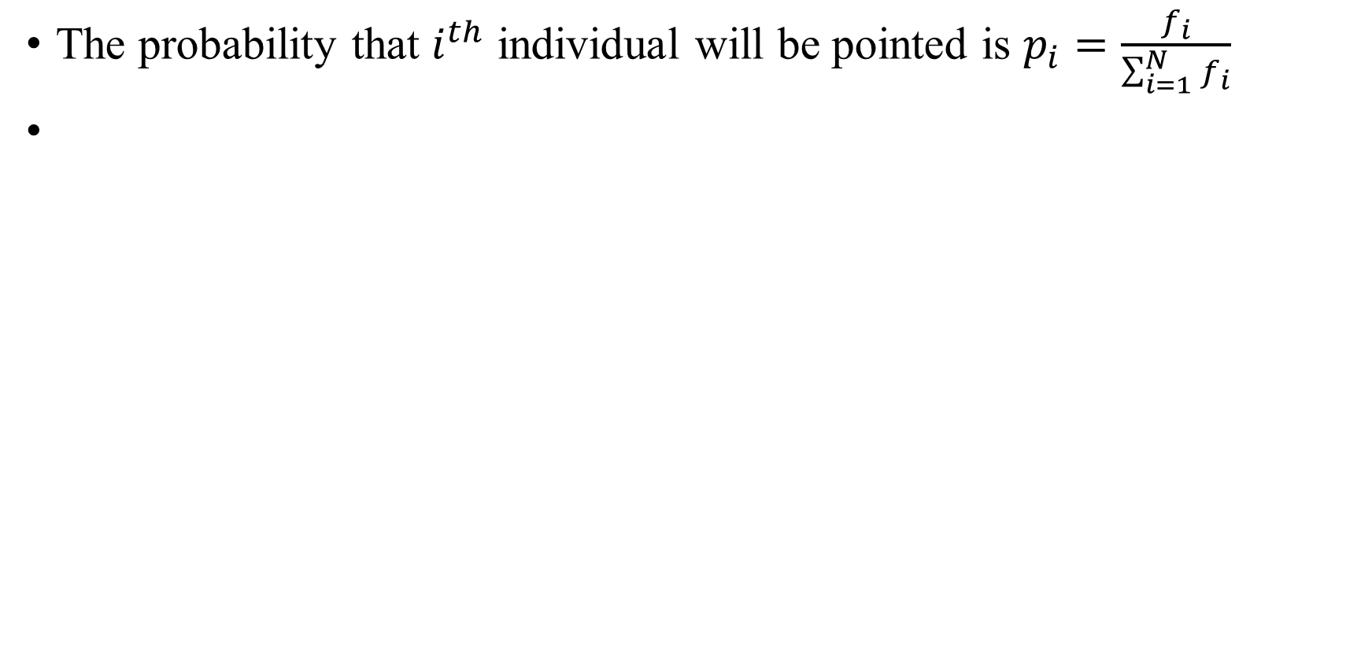
Roulette-Wheel selection: Example
The probability that $i^{th}$ individual will be pointed is $p_{i}=\frac{f_{i}}{\sum_{i=1}^{N}{f_{i}}}$

Slide 37
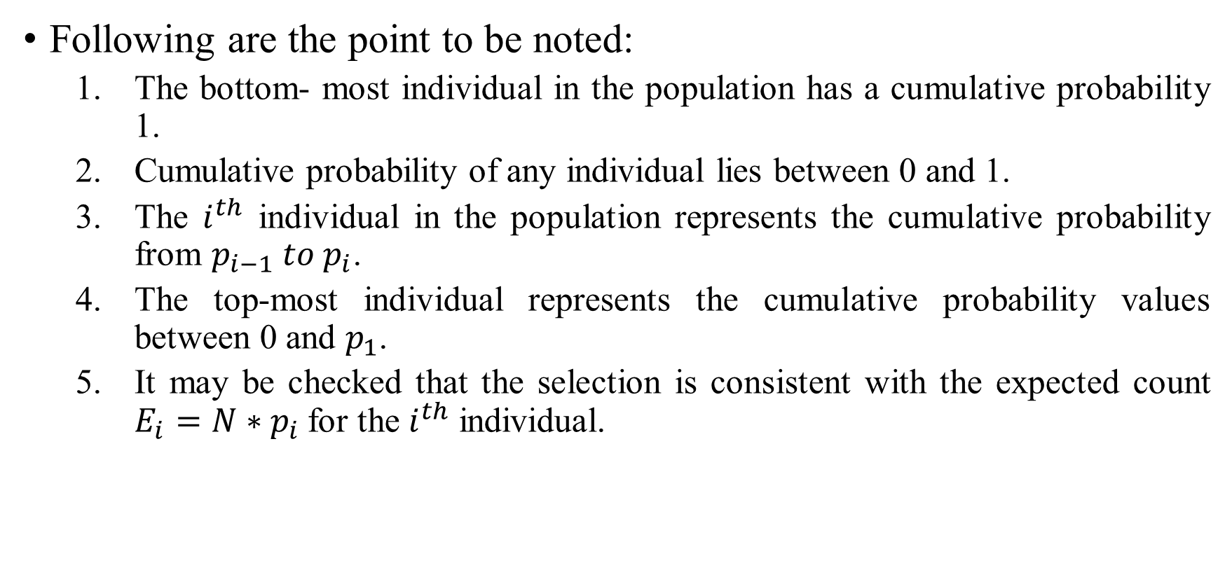
Roulette-Wheel selection
Following are the point to be noted:
The bottom‐ most individual in the population has a cumulative probability 1.
Cumulative probability of any individual lies between 0 and 1.
The $i^{th}$ individual in the population represents the cumulative probability from $p_{i−1} to p_{i}$.
The top‐most individual represents the cumulative probability values between 0 and $p_{1}$.
It may be checked that the selection is consistent with the expected count $E_{i}=N∗p_{i}$for the $i^{th}$ individual.

Slide 38
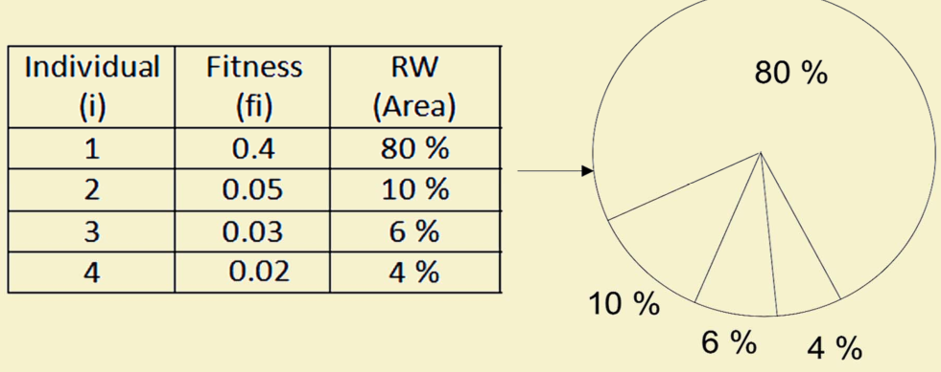
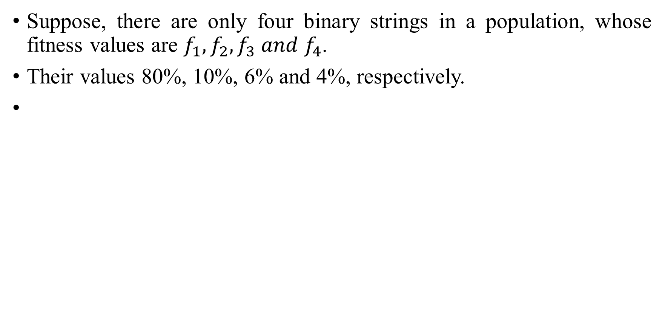
Drawback in Roulette-Wheel selection
Suppose, there are only four binary strings in a population, whose fitness values are $f_{1},f_{2},f_{3} and f_{4}$.
Their values 80%, 10%, 6% and 4%, respectively.

Slide 39
Drawback in Roulette-Wheel selection
The observation is that the individual with higher fitness values will guard the other to be selected for mating.
This leads to a lesser diversity and hence fewer scope toward exploring the alternative solution and also premature convergence or early convergence with local optimal solution.

Slide 40
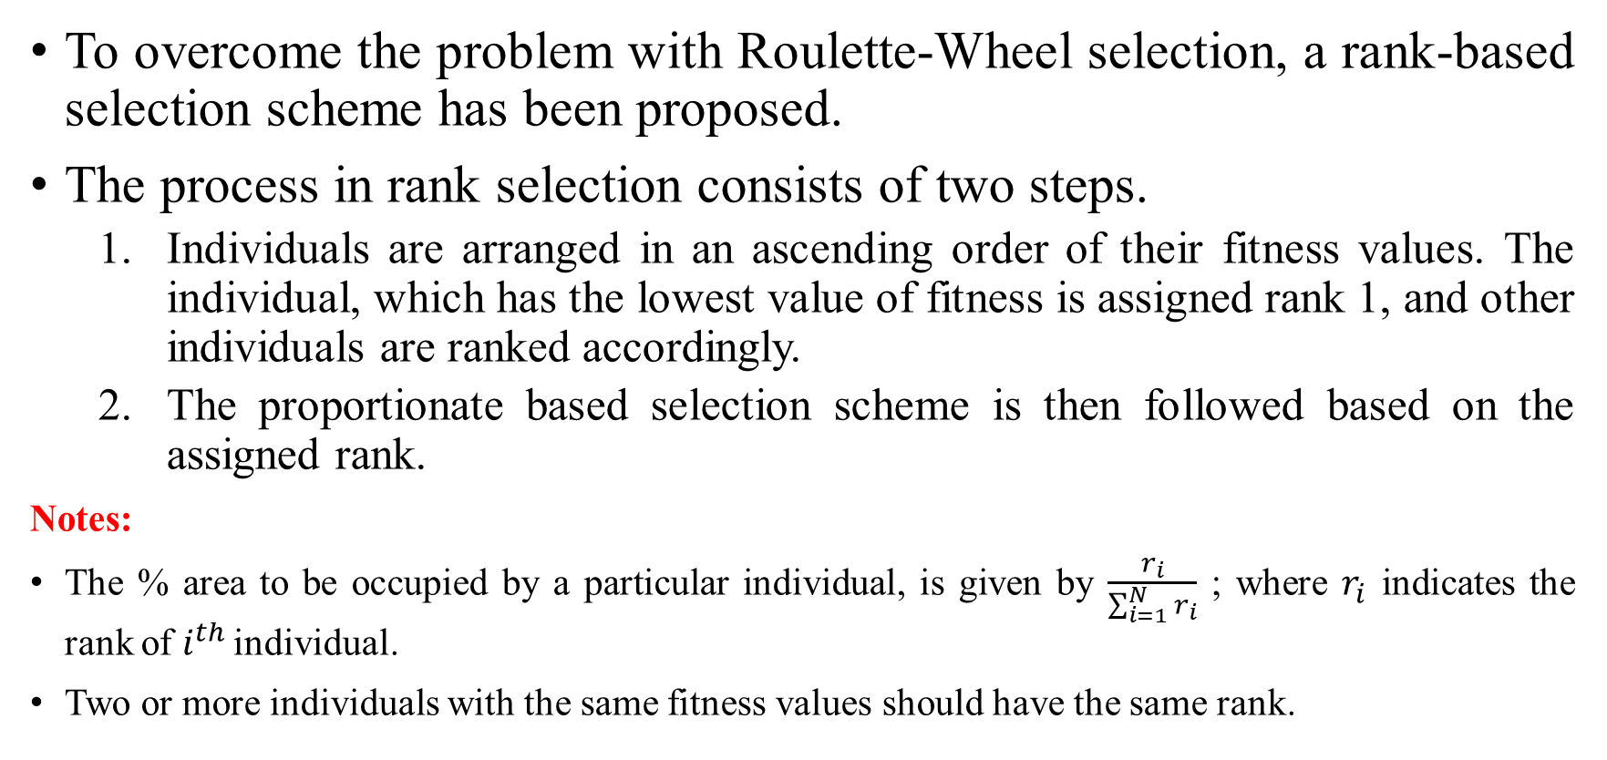
Rank-based selection
To overcome the problem with Roulette‐Wheel selection, a rank‐based selection scheme has been proposed.
The process in rank selection consists of two steps.
Individuals are arranged in an ascending order of their fitness values. The individual, which has the lowest value of fitness is assigned rank 1, and other individuals are ranked accordingly.
The proportionate based selection scheme is then followed based on the assigned rank.
Notes:
The % area to be occupied by a particular individual, is given by $\frac{r_{i}}{\sum_{i=1}^{N}{r_{i}}}$ ; where $r_{i}$ indicates the rank of $i^{th }$individual.
Two or more individuals with the same fitness values should have the same rank.

Slide 41
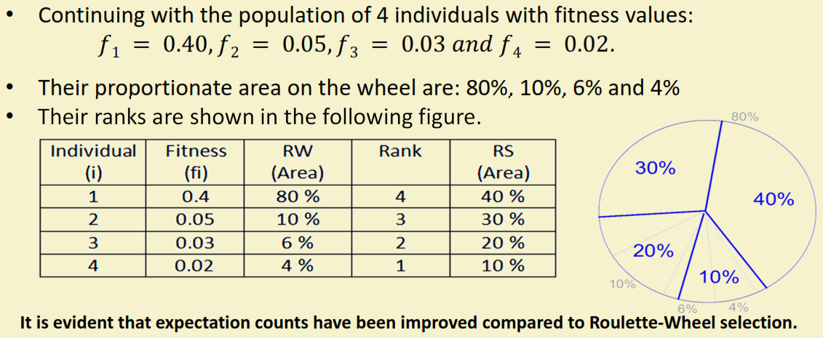
Rank-based selection: Example

Slide 42
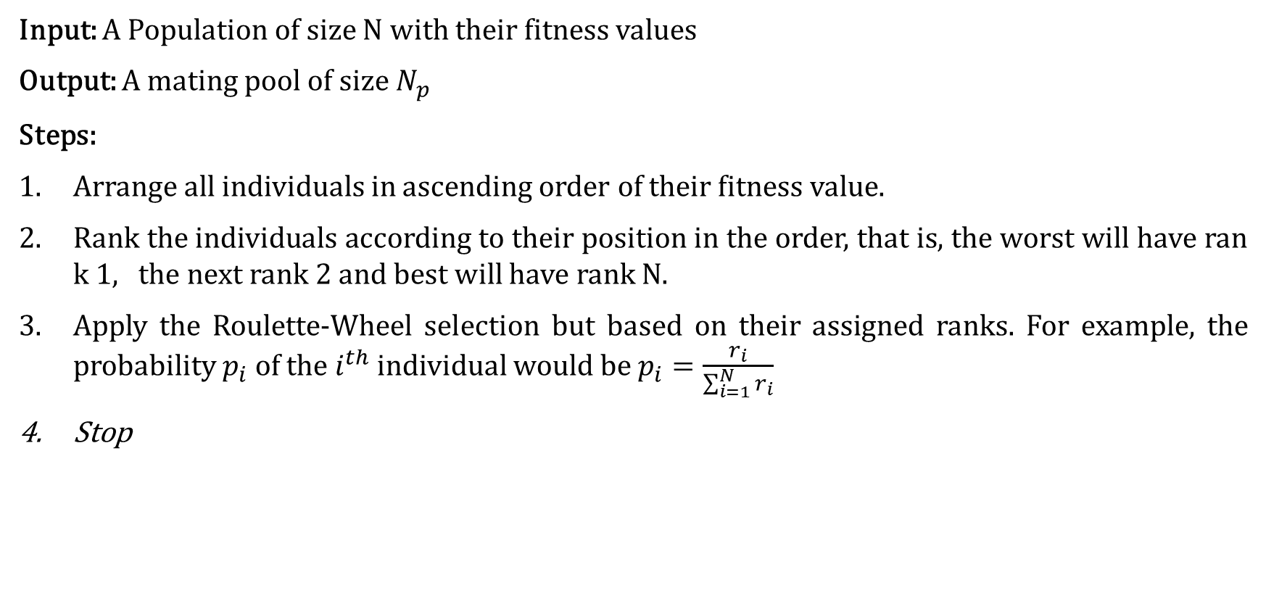
Rank-based selection: Implementation
Input: A Population of size N with their fitness values
Output: A mating pool of size $N_{p}$
Steps:
Arrange all individuals in ascending order of their fitness value.
Rank the individuals according to their position in the order, that is, the worst will have rank 1, the next rank 2 and best will have rank N.
Apply the Roulette‐Wheel selection but based on their assigned ranks. For example, the probability $p_{i}$ of the $i^{th}$ individual would be $p_{i}=\frac{r_{i}}{\sum_{i=1}^{N}{r_{i}}}$
Stop

Slide 43
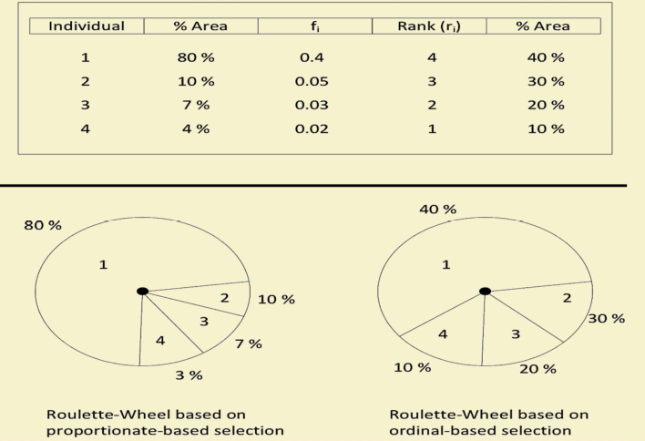
Comparing Rank-based selection with Roulette- Wheel selection

Slide 44
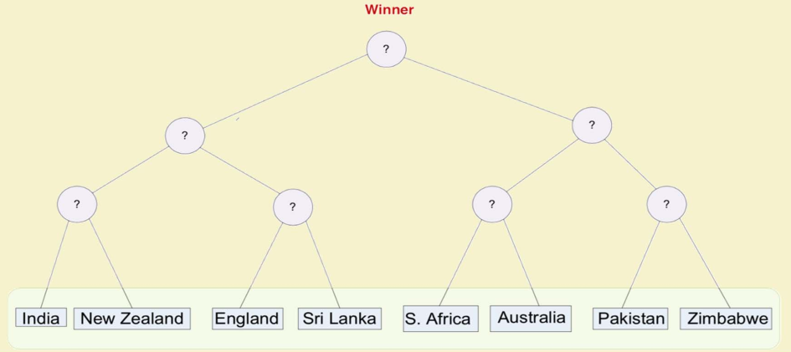
Tournament Selection
Who will win the match in this tournament?

Slide 45
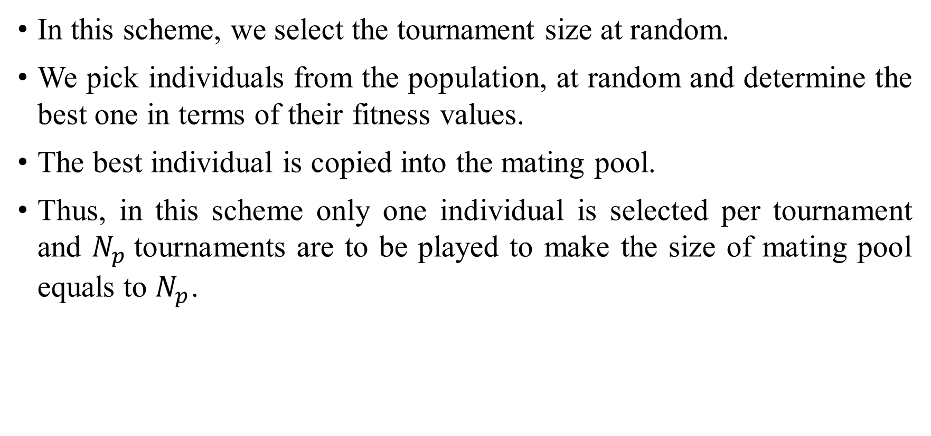
Tournament Selection
In this scheme, we select the tournament size at random.
We pick individuals from the population, at random and determine the best one in terms of their fitness values.
The best individual is copied into the mating pool.
Thus, in this scheme only one individual is selected per tournament and $N_{p}$tournaments are to be played to make the size of mating pool equals to $N_{p}$.

Slide 46
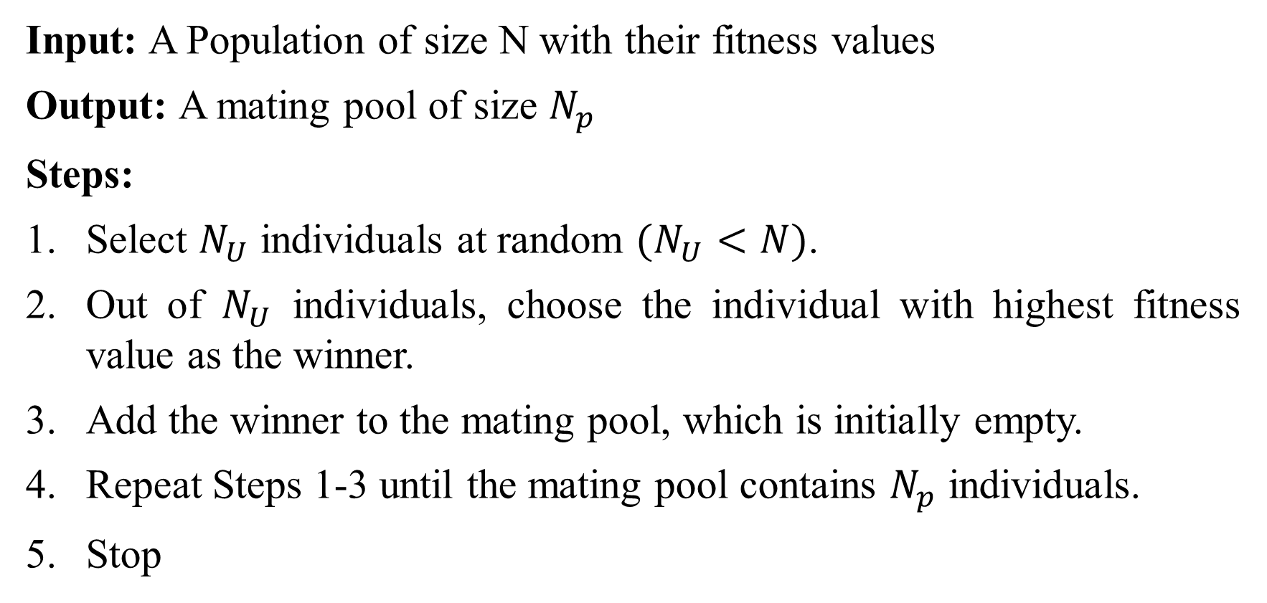
Tournament Selection: Implementation
Input: A Population of size N with their fitness values
Output: A mating pool of size $N_{p}$
Steps:
Select $N_{U}$ individuals at random $(N_{U}<N)$.
Out of $N_{U}$ individuals, choose the individual with highest fitness value as the winner.
Add the winner to the mating pool, which is initially empty.
Repeat Steps 1‐3 until the mating pool contains $N_{p}$ individuals.
Stop

Slide 47
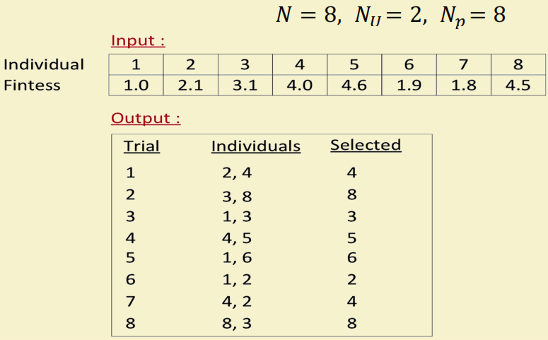
Tournament Selection: Example

Slide 48
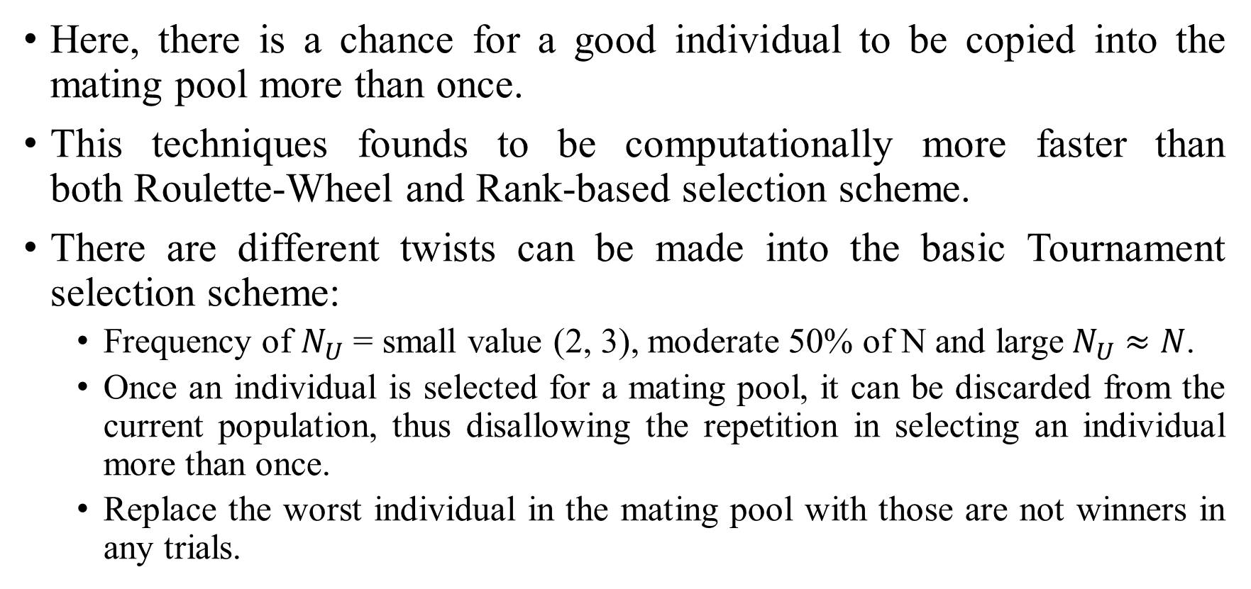
Tournament Selection:
Here, there is a chance for a good individual to be copied into the mating pool more than once.
This techniques founds to be computationally more faster than both Roulette‐Wheel and Rank‐based selection scheme.
There are different twists can be made into the basic Tournament selection scheme:
Frequency of $N_{U}$ = small value (2, 3), moderate 50% of N and large${ N}_{U} ≈N$.
Once an individual is selected for a mating pool, it can be discarded from the current population, thus disallowing the repetition in selecting an individual more than once.
Replace the worst individual in the mating pool with those are not winners in any trials.

Slide 50
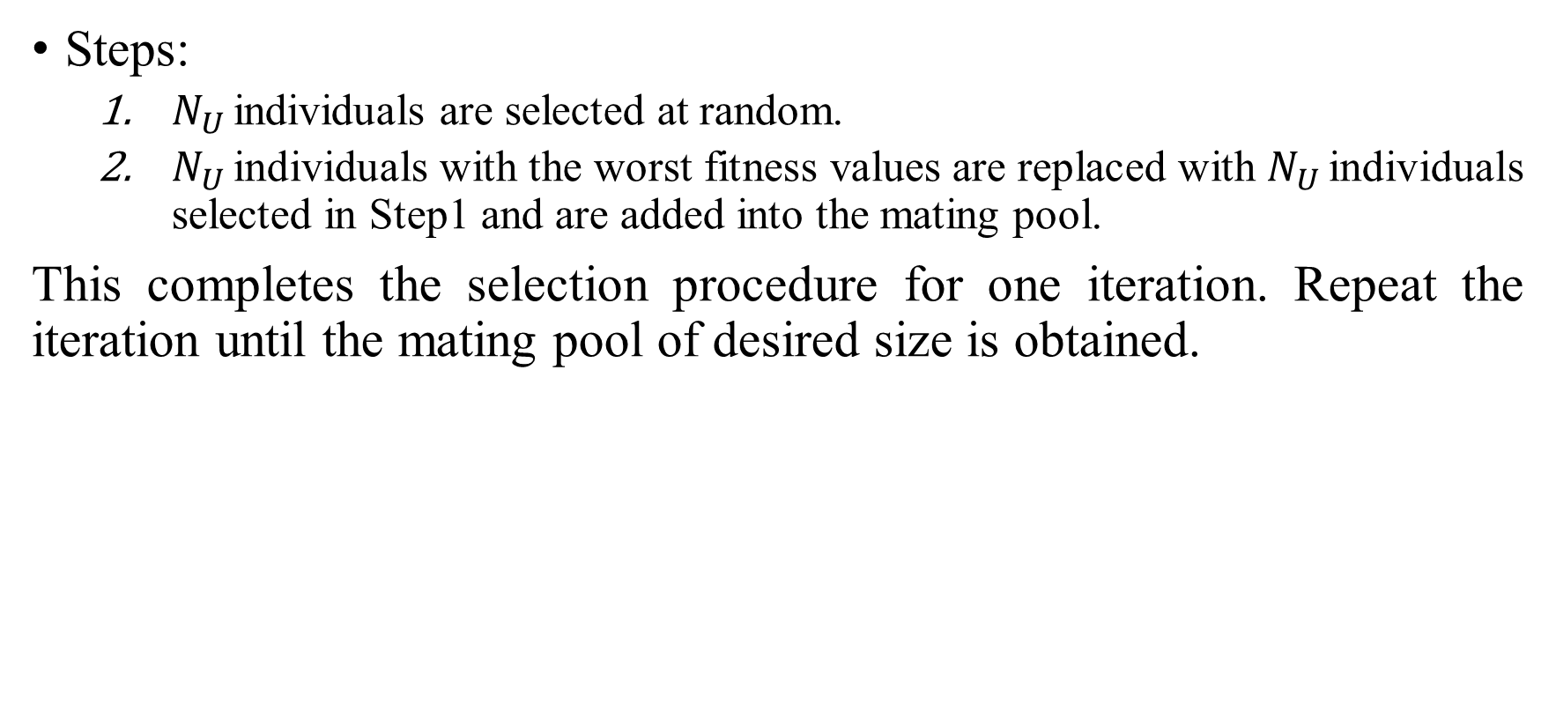
Steady-State selection algorithm:
Steps:
$N_{U }$individuals are selected at random.
$N_{U }$individuals with the worst fitness values are replaced with $N_{U }$individuals selected in Step1 and are added into the mating pool.
This completes the selection procedure for one iteration. Repeat the iteration until the mating pool of desired size is obtained.

Slide 51
Effectiveness of any selection scheme:
These two factors are inversely related to each other in the sense that if the selection pressure increases, the population diversity decrease and vice‐versa.
Thus,
If selection pressure is HIGH
The search focuses only on good individuals (in terms of fitness) at the moment.
It loses the population diversity.
Higher rate of convergence. Often leads to pre‐mature convergence of the solution to a sub‐optimal solution.
If the selection pressure is LOW
May not be able to drive the search properly and consequently the stagnation may occurs.
The convergence rate is low and GA takes unnecessary long time to find optimal solution.
Accuracy of solution increases (as more genes are usually explored in the search).

Slide 52
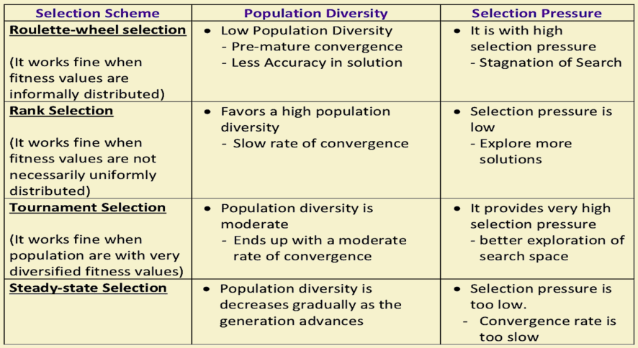
Analysis of different selection strategies

Slide 53
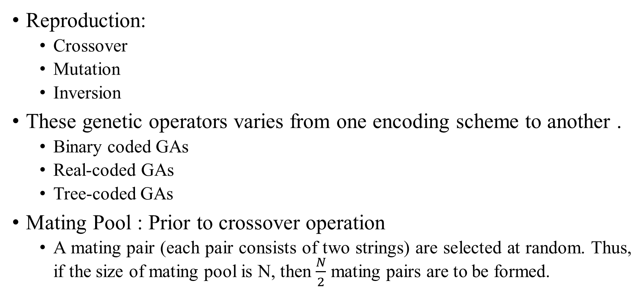
Reproduction in Genetic Algorithm
Reproduction:
Crossover
Mutation
Inversion
These genetic operators varies from one encoding scheme to another .
Binary coded GAs
Real‐coded GAs
Tree‐coded GAs
Mating Pool : Prior to crossover operation
A mating pair (each pair consists of two strings) are selected at random. Thus, if the size of mating pool is N, then $\frac{N}{2}$ mating pairs are to be formed.

Slide 54
Crossover operation
Once, a pool of mating pair are selected, they undergo through crossover operations.
In crossover, there is an exchange of properties between two parents and as a result of which two offspring solutions are produced.
The crossover point (s) (also called k‐point(s)) is (are) decided using a random number generator generating integer(s) in between 1and L, where L is the length of the chromosome.
Then we perform exchange of gene values with respect to the k‐point(s)
There are many exchange mechanisms and hence crossover strategies.

Slide 55
Crossover operation in Binary Coded GA’s
There exists a large number of crossover schemes, few important of them are listed in the following.
Single point crossover
Two‐point crossover
Multi‐point crossover (also called n‐point crossover)
Uniform crossover (UX)
Half‐uniform crossover (HUX)
Shuffle crossover
Three‐parent crossover

Slide 56
Single point crossover
Here, we select the k‐point lying between 1 and L. Let it be k.
A single crossover point at k on both parent’s strings is selected.
All data beyond that point in either string is swapped between the two parents.
The resulting strings are the chromosomes of the offspring produced.

Slide 57
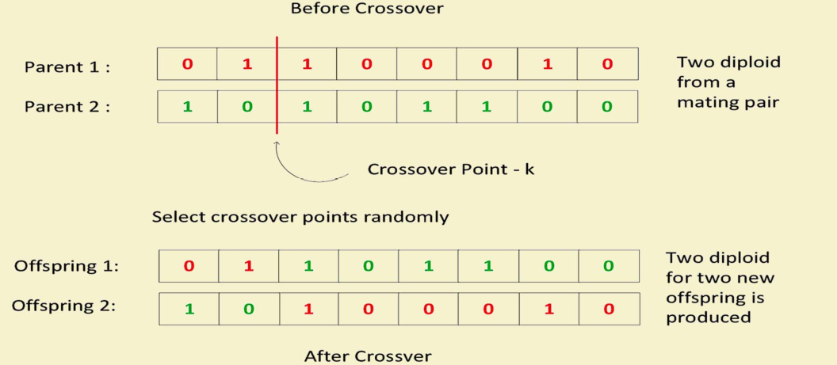
Single point crossover: Illustration

Slide 58
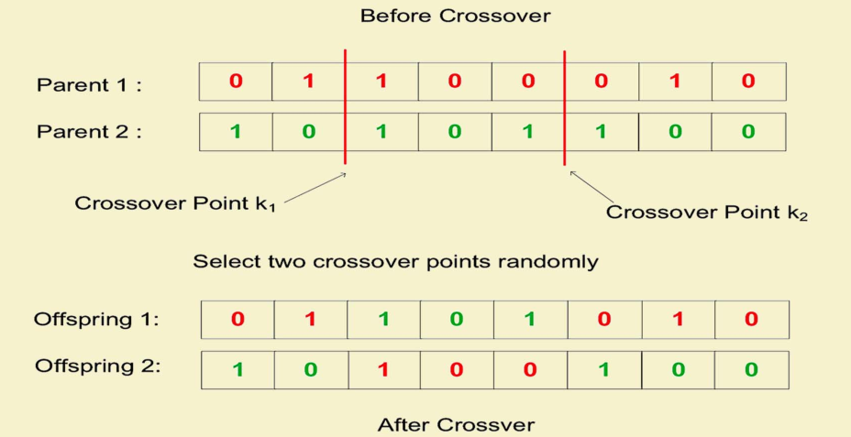
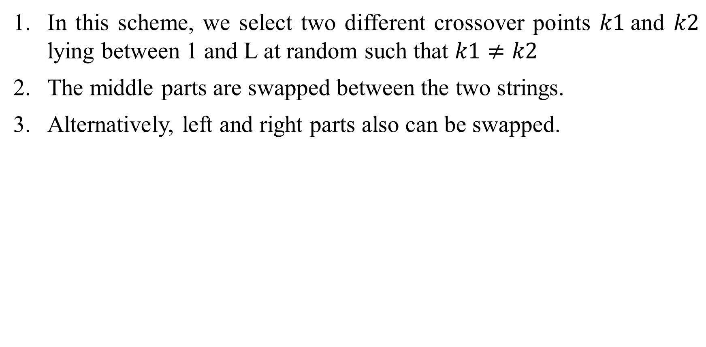
Two‐Point Crossover
In this scheme, we select two different crossover points $k1$and $k2$ lying between 1 and L at random such that $k1≠k2$
The middle parts are swapped between the two strings.
Alternatively, left and right parts also can be swapped.

Slide 59
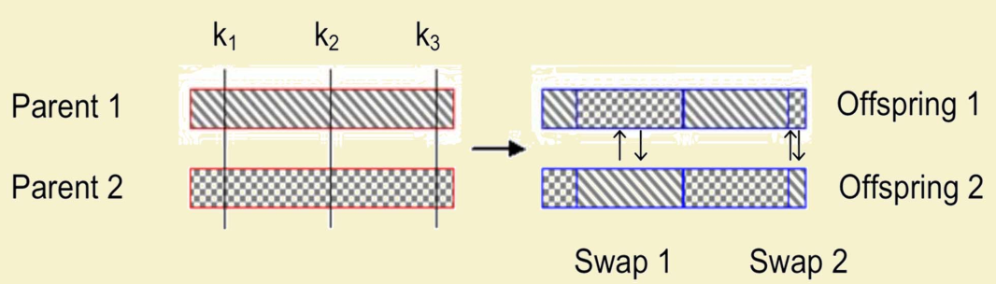
Multi‐Point Crossover
In case of multi‐point crossover, a number of crossover points are selected along the length of the string, at random.
The bits lying between alternate pairs of sites are then swapped.

Slide 60
Uniform Crossover (UX)
Uniform crossover is a more general version of the multi‐point crossover .
In this scheme, at each bit position of the parent string, we toss a coin (with a certain probability) to determine whether there will be swap of the bits or not.
The two bits are then swapped or remain unaltered, accordingly.

Slide 61
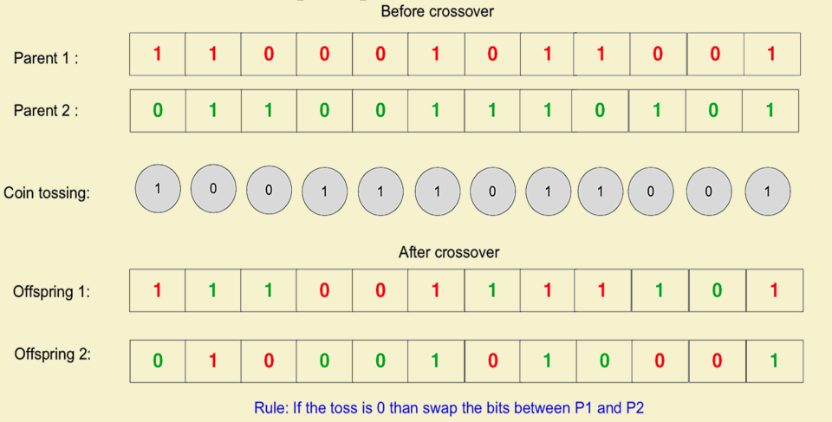
Uniform Crossover (UX): Illustration

Slide 62
Uniform crossover with crossover mask
Here, each gene is created in the offspring by copying the corresponding gene from one or the other parent chosen according to a random generated binary crossover mask of the same length as the chromosome.
Where there is a 1 in the mask, the gene is copied from the first parent.
Where there is a 0 in the mask, the gene is copied from the second parent.
The reverse is followed to create another offspring.

Slide 63
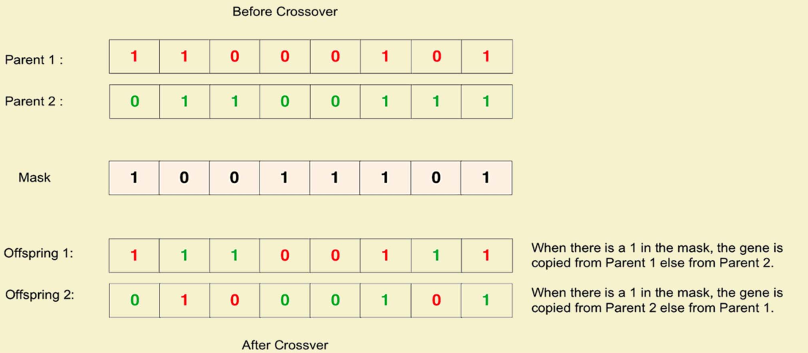
Uniform crossover with crossover mask: Illustration

Slide 64
Half-uniform crossover (HUX)
In the half uniform crossover scheme, exactly half of the non‐matching bits are swapped.
Calculate the Hamming distance (the number of differing bits) between the given parents.
This number is then divided by two.
The resulting number is how many of the bits that do not match between the two parents will be swapped but probabilistically.
Choose the locations of these half numbers (with some strategies, say coin tossing) and swap them.

Slide 65
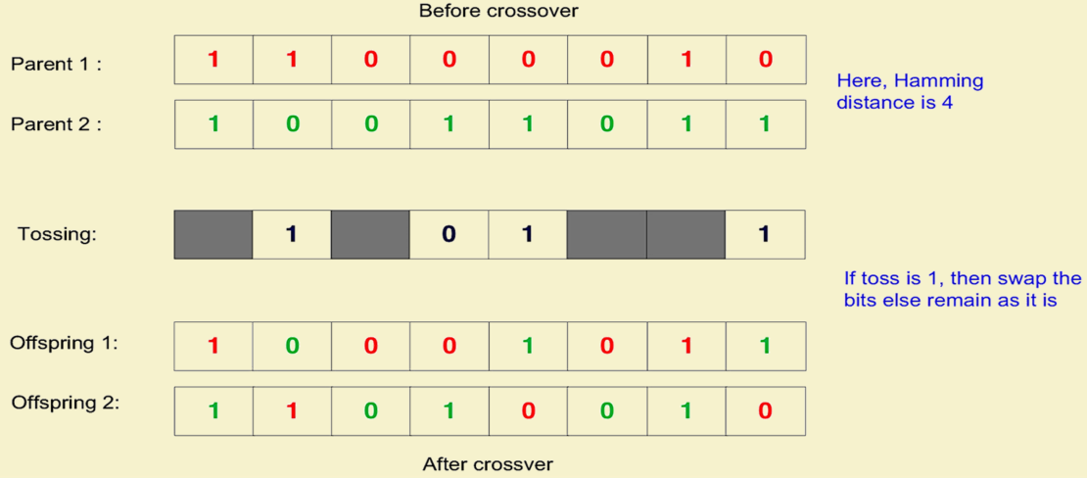
Half-uniform crossover (HUX): Illustration

Slide 66
Shuffle crossover
A single crossover point is selected. It divides a chromosome into two parts called schema.
In both parents, genes are shuffled in each schema. Follow some strategy for shuffling bits.
Schemas are exchanged to create offspring (as in single‐point crossover)

Slide 67
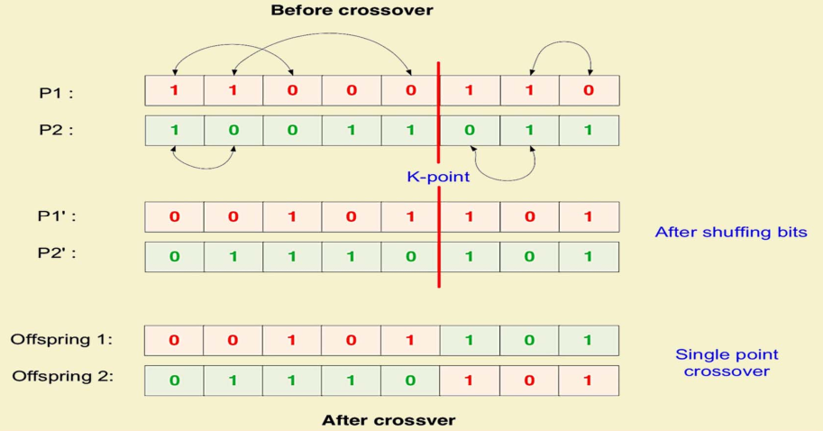
Shuffle crossover: Illustration

Slide 68
Three parent crossover
In this technique, three parents are randomly chosen from the current population.
Each bit of the first parent is compared with the bit of the second parent.
If both are the same, the bit is taken for the offspring.
Otherwise, the bit from the third parent is taken for the offspring.

Slide 69
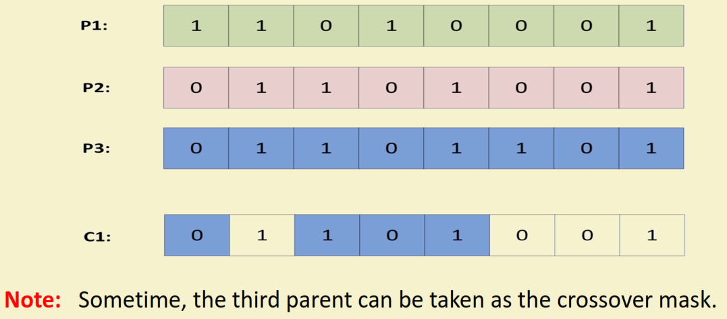
Three parent crossover: Illustration

Slide 70
Crossover techniques in Real coded GA
Following are the few well known crossover techniques for the real-coded GAs.
Linear crossover
Blend crossover
Binary simulated crossover

Slide 71
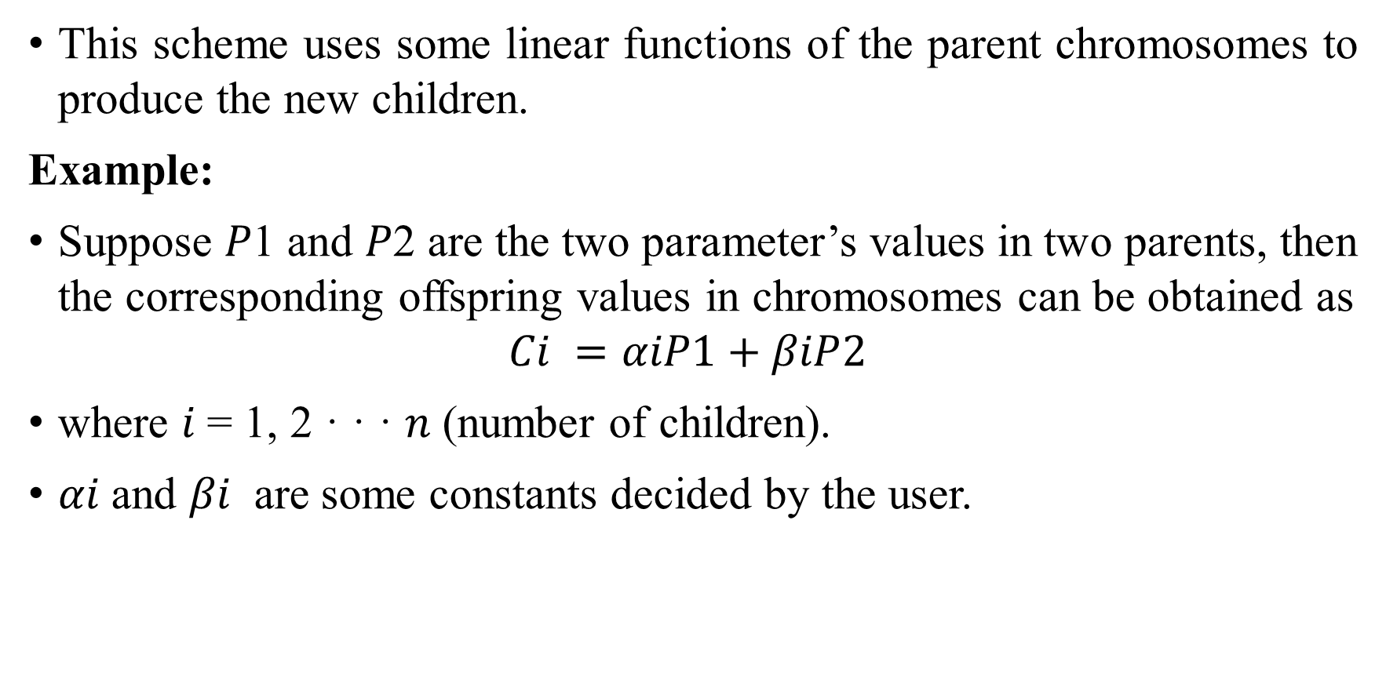
Linear crossover in Real-coded GAs
This scheme uses some linear functions of the parent chromosomes to produce the new children.
Example:
Suppose 𝑃1 and 𝑃2 are the two parameter’s values in two parents, then the corresponding offspring values in chromosomes can be obtained as
$$Ci =αiP1+βiP2$$
where 𝑖 = 1, 2 · · · 𝑛 (number of children).
𝛼𝑖 and 𝛽𝑖 are some constants decided by the user.

Slide 72
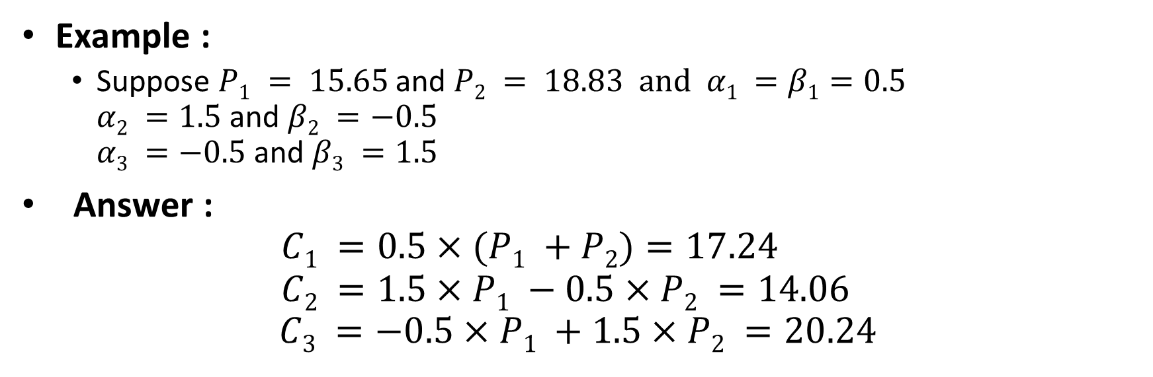
Linear crossover: An example
Example :
Suppose $P1 = 15.65$and $P2 = 18.83 and α1 =β1=0.5$ $α2 =1.5$and $β2 =−0.5$ $α3 =−0.5$and $β3 =1.5$
Answer : $C1 =0.5×(P1 +P2)=17.24$ $C2 =1.5×P1 −0.5×P2 =14.06$
$$C3 =−0.5×P1 +1.5×P2 =20.24$$

Slide 73
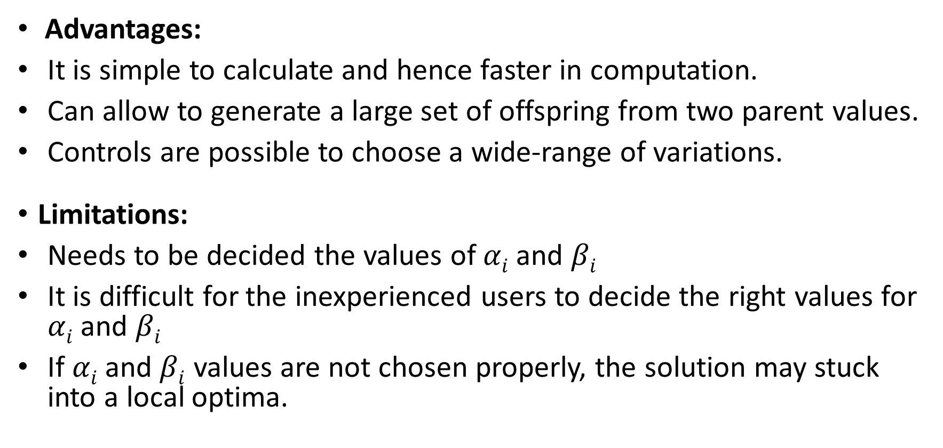
Advantages & Limitations
Advantages:
It is simple to calculate and hence faster in computation.
Can allow to generate a large set of offspring from two parent values.
Controls are possible to choose a wide-range of variations.
Limitations:
Needs to be decided the values of $αi$and $βi$
It is difficult for the inexperienced users to decide the right values for $αi$ and $βi$
If $αi$ and $βi$ values are not chosen properly, the solution may stuck into a local optima.

Slide 74
Blend crossover in Real-coded GAs
This scheme can be stated as follows.
Let $P1$ and $P2$ are the two parameter’s values in two parent’s chromosomes, such that $P1 < P2$.
Then the blend crossover scheme creates the children solution lying in the range
$$⟨\{P1 −α(P2 −P1)\}···\{P2 −α(P2 −P1)\}⟩$$
where $α$ is a constant to be decided so that children solution do not come out of the range of domain of the said parameter.

Slide 75
Blend crossover in Real-coded GAs
Another parameter $γ$ has to be identified by utilizing the $α$ and a random number $r$ in the range of $(0.0, 1.0)$both exclusive like the following:
$$γ = (1 + 2α) r − α$$
The children solutions $C1$ and $C2$ are determined from the parents as follows,
$$C1 = (1 − γ) P1 + γP2$$
$$C2 = (1 − γ) P2 + γP1$$

Slide 76
Blend crossover : An example
Example :
$P1 = 15.65$and $P2 = 18.83$
$α = 0.5$and $γ = 0.6$

Slide 77
Advantages and limitations
Advantages:
It is simple to calculate and also faster in computation.
Can allow to generate a large set of offspring from two parent values.
Controls are possible to choose a wide-range of variations.
Limitations:
Needs to be decided the values of $α$and$γ$
It is difficult for the inexperienced users to decide the right values for $α$and$γ$
If $α$and$γ$values are not chosen properly, the solution may stuck into a local optima.

Slide 78
Simulated binary crossover in Real-coded GAs
This scheme is based on the probability distribution of generated children solution from the given parents.
A spread factor $α$ is used to represent the spread of the children solutions with respect to that of the parents, as given below.
$$α=\frac{C_{1}−C_{2}}{P_{1}−P_{2}}$$
Here, $P_{1}$ and $P_{2}$ are represent the parent points and $C_{1}$ and $C_{2}$ are two children solutions.

Slide 79
Simulated binary crossover in Real-coded GAs
Three different cases may occurs:
Case 1: $α < 1$(Contracting Crossover) The spread of children is less than the parents.
Case 2: $α > 1$(Expanding Crossover) The spread of children is more than the parents.
Case 3: $α = 1$(Stationary Crossover) The spread of children is same as that of the parents.

Slide 80
Simulated Binary Crossover
Probability Distribution:
Case 1: For Contracting Crossover
$$C\left(α\right)= 0.5\left(q + 1\right)α2$$
Case 2: For Expanding Crossover
$$E\left(α\right)=0.5(q+1)\frac{1}{α^{q+2}}$$
Here, q is a parameter chosen by the user.

Slide 81
Simulated binary crossover in Real-coded GAs
Following steps are used to create two children solutions $C1$ and $C2$ from the parents $P1$ and $P2$.
Create a random number $r ∈ \{0.0 · · · 1.0\}$
Determine $α′$ such that
$\int_{0}^{α′}{C\left(α\right)dα=r, if r<0.5}$ and
$$\int_{1}^{α′}{E\left(α\right)dα=r, if r>0.5}$$
Using the value of $α′$ obtain two children solution as follows
$C1 =0.5[(P1 +P2)−α′|P2 −P1|]$
$C2 =0.5[(P1 +P2)+α′|P2 −P1|]$

Slide 82
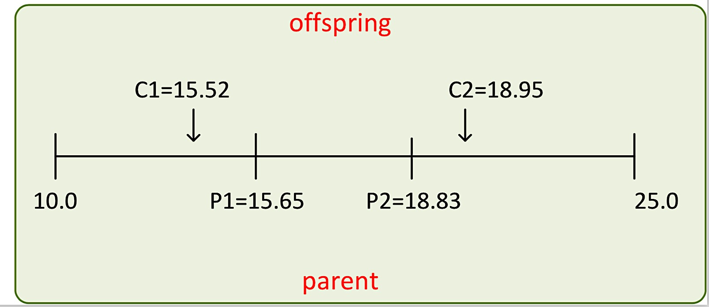
Simulated binary crossover in Real-coded GAs
Example:
$$P1 = 15.65 P2 = 18.83 \\ q=2 α′ = 1.0772$$ Assuming expanding crossover with $r > 0.5$

Slide 83
Advantages
Advantages
We can generate a large number of offspring from two parents.
More explorations with diverse offspring.
Results are accurate and usually terminated with global optima.
Termination with a less number of iterations.
Crossover techniques are independent of the length of the chromosome.

Slide 84
Advantages and limitations
Limitations
Computationally expensive compared to binary crossover.
If proper values of parameters involved in the crossover techniques are not chosen judiciously, then it may lead to premature convergence with not necessarily optimum solutions.

